Slide 1
DIGITAL PORTFOLIO
STUDENT NAME : HARINI JANARTHANAN
REGISTER NO AND NMID : asunm1397222406213
DEPARTMENT : BSC COMPUTER SCIENCE WITH DATA SCIENCE
COLLEGE: COLLEGE/ UNIVERSITY : SRM ARTS AND SCIENCE COLLEGE /MADRAS UNIVERSITY

Slide 2
PROJECT TITLE
Student Digital Portfolio Using
Front-end Development

Slide 3


AGENDA
Problem Statement
Project Overview
End Users
Tools and Technologies
Portfolio design and Layout
Features and Functionality
Results and Screenshots
Conclusion
Github Link
3/21/2024 Annual Review

Slide 4

PROBLEM STATEMENT
Students often face challenges in showcasing their skills, achievements, and learning journey in a structured and accessible way. Traditional paper-based portfolios are limited, difficult to update, and fail to reflect a student’s complete range of talents, including digital skills, projects, extracurricular activities, and creative works. Employers and educators increasingly expect a dynamic and professional representation of a student’s abilities. However, the absence of an organized, user-friendly, and technology-driven platform makes it difficult for students to present their competencies effectively.

Slide 5

PROJECT OVERVIEW
A project overview for a student digital portfolio PPT should cover the project's purpose, scope, and goals. It should include sections for your introduction and contact information, your selected best work (showcase), evidence of your learning process, reflections, your goals, and your resume or contact information. Structure the presentation with a consistent, visually appealing design, highlighting your best projects with clear descriptions and engaging visuals to demonstrate your skills and growth.

Slide 6

WHO ARE THE END USERS?
Students
Teachers / Mentors
Educational Institutions
Recruiters / Employers
Higher Education Institutions
Parents / Guardians

Slide 7

TOOLS AND TECHNIQUES
HTML → for structuring the portfolio web pages
CSS → for styling and responsive design
JavaScript → for interactivity and dynamic content
Code Editors → VS Code, Sublime Text, or any preferred editor
Version Control→ Git / GitHub for tracking changes and collaboration

Slide 8
PORTFOLIO DESIGN AND LAYOUT
About
Skills
Education
Projects
Resume
8

Slide 9
FEATURES AND FUNCTIONALITY
Personal Profile Section → Displays name, photo, department, and bio.
Education Section → Academic details with institution and degree info.
Skills Section → Technical & soft skills listed clearly.
Projects Showcase → Links or descriptions of student projects.
Resume Download → Option to download CV in DOCX/PDF format.
Navigation Bar → Quick access to different sections.
Responsive Design → Works on laptop, tablet, and mobile.
Custom Styling → Background colors, profile picture, hover effects.

Slide 10
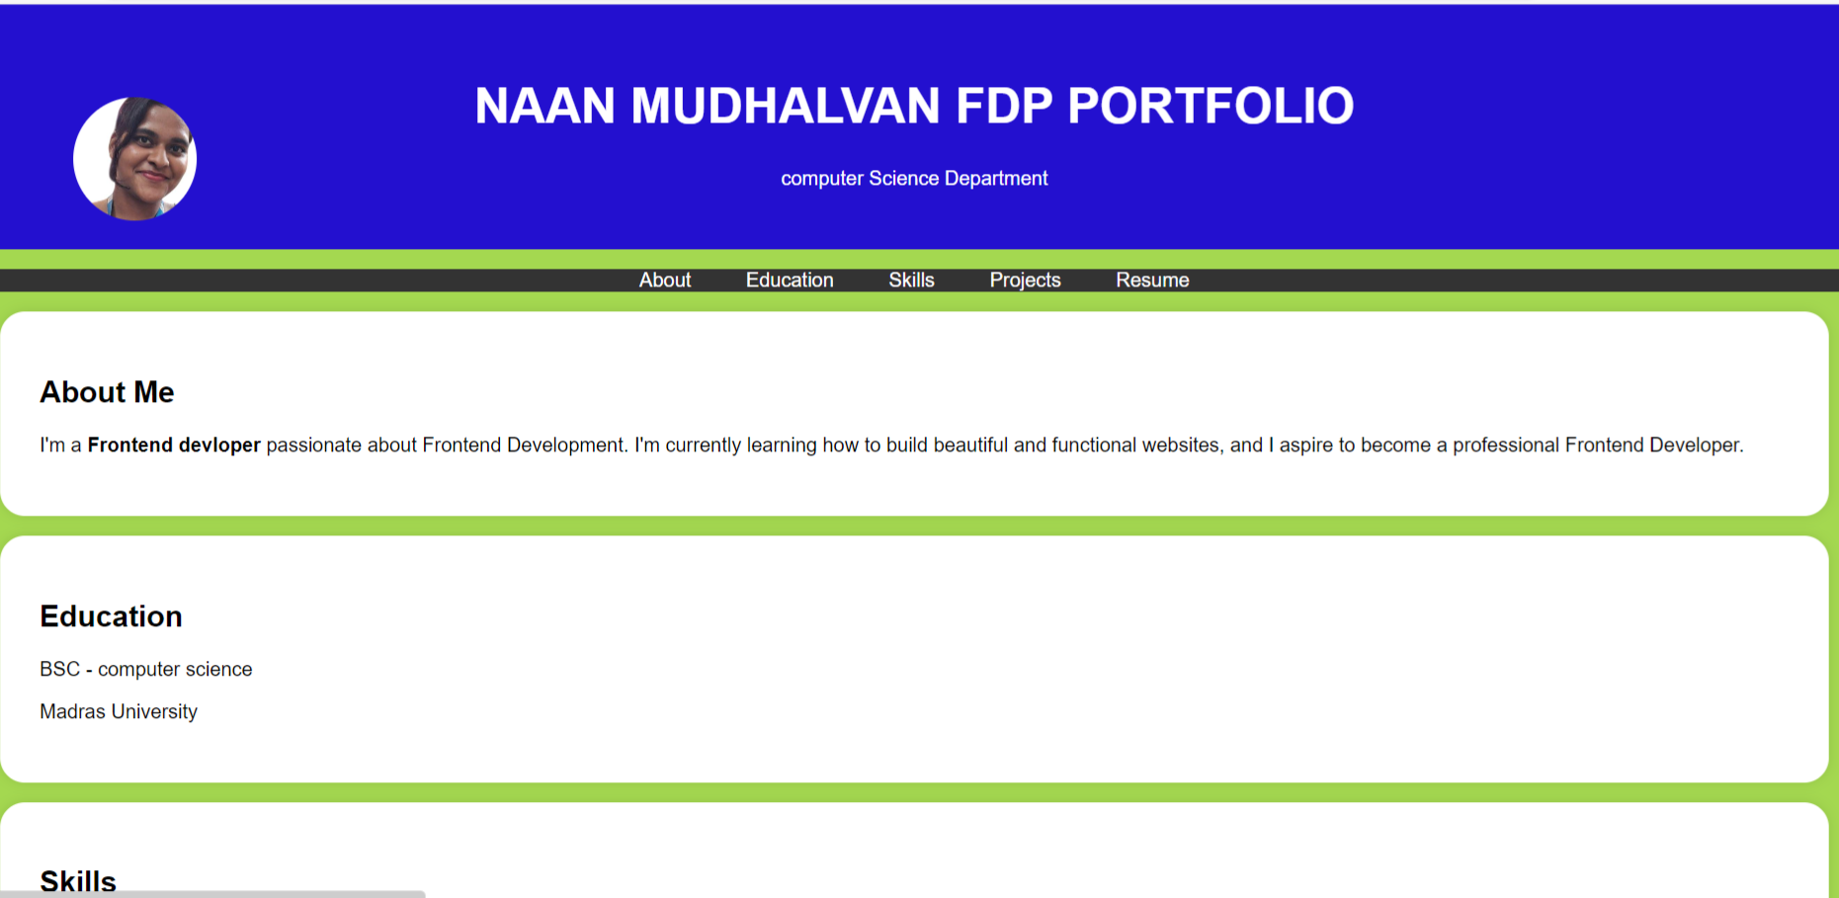

RESULTS AND SCREENSHOTS
3/21/2024 Annual Review
10

Slide 11
CONCLUSION
A student digital portfolio serves as a powerful tool to showcase academic achievements, technical skills, projects, and personal growth in an organized and professional manner. Unlike traditional portfolios, it provides flexibility, accessibility, and the ability to continuously update accomplishments. By integrating creativity, technology, and self-reflection, a digital portfolio not only enhances learning but also improves career and higher education opportunities. Ultimately, it empowers students to present their unique identity, skills, and potential effectively to educators, employers, and the global community.
11

